Slide 1
Random_1 Classification Results (GUO)

Slide 2
Overview
Here's where the overview goes

Slide 3
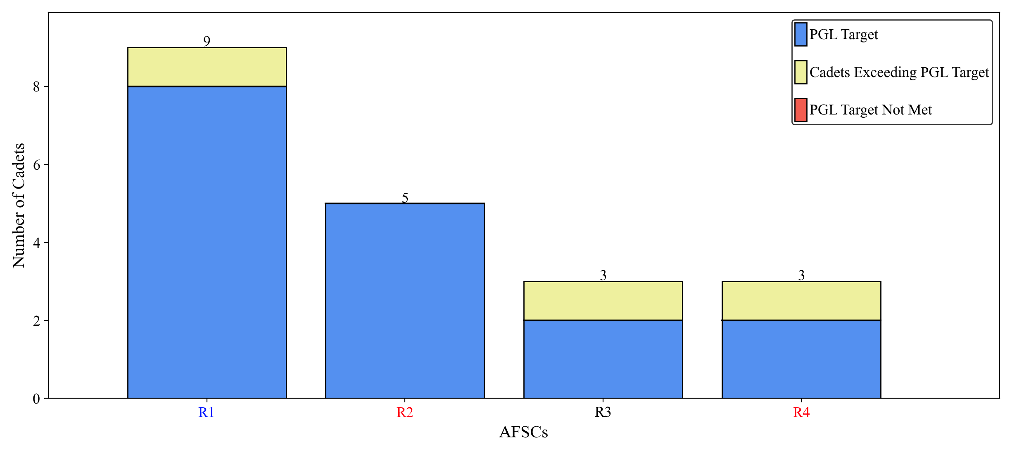
PGL

Slide 4
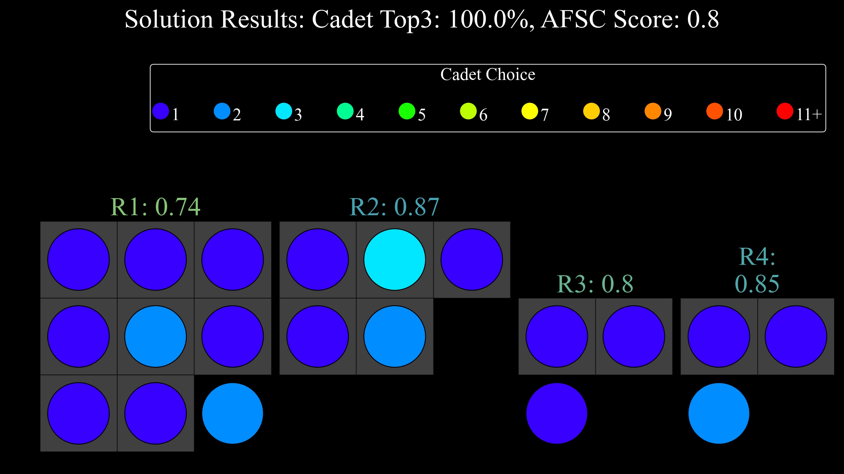

Slide 5
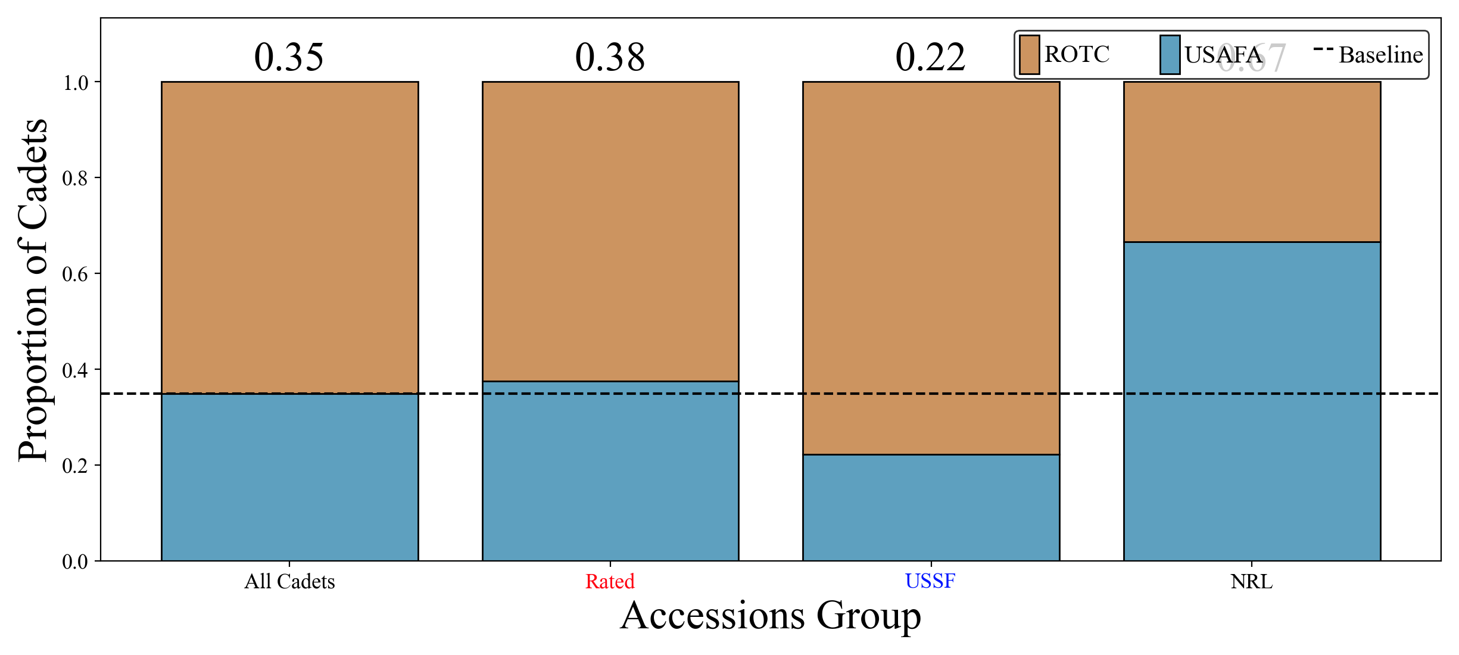
SOC by Accessions Group

Slide 6
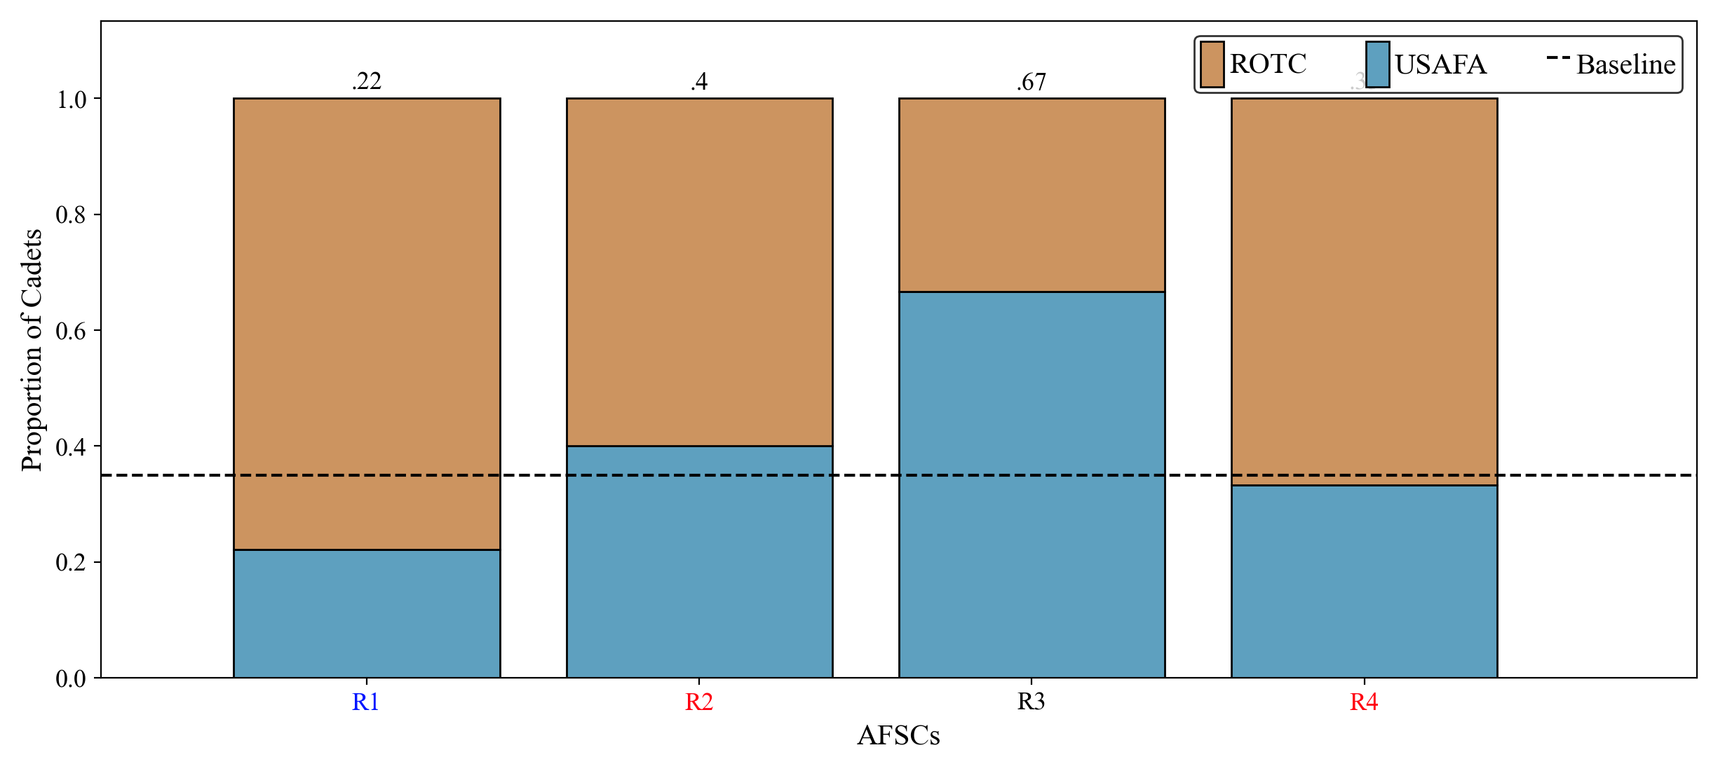
SOC by AFSC

Slide 7
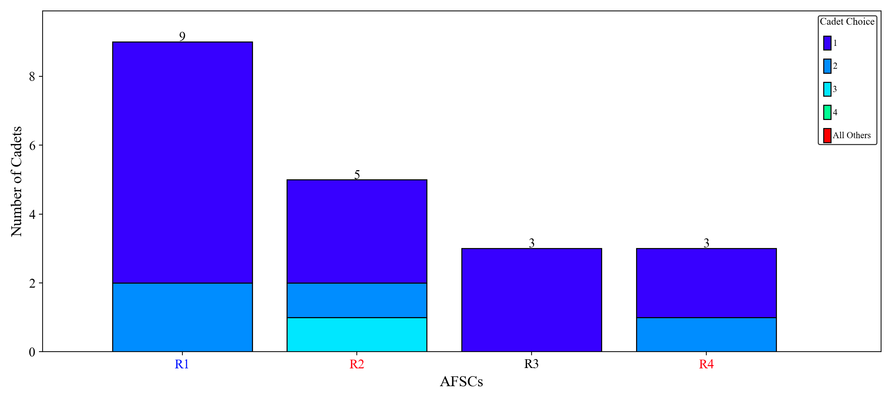
Cadet Preference by AFSC

Slide 8
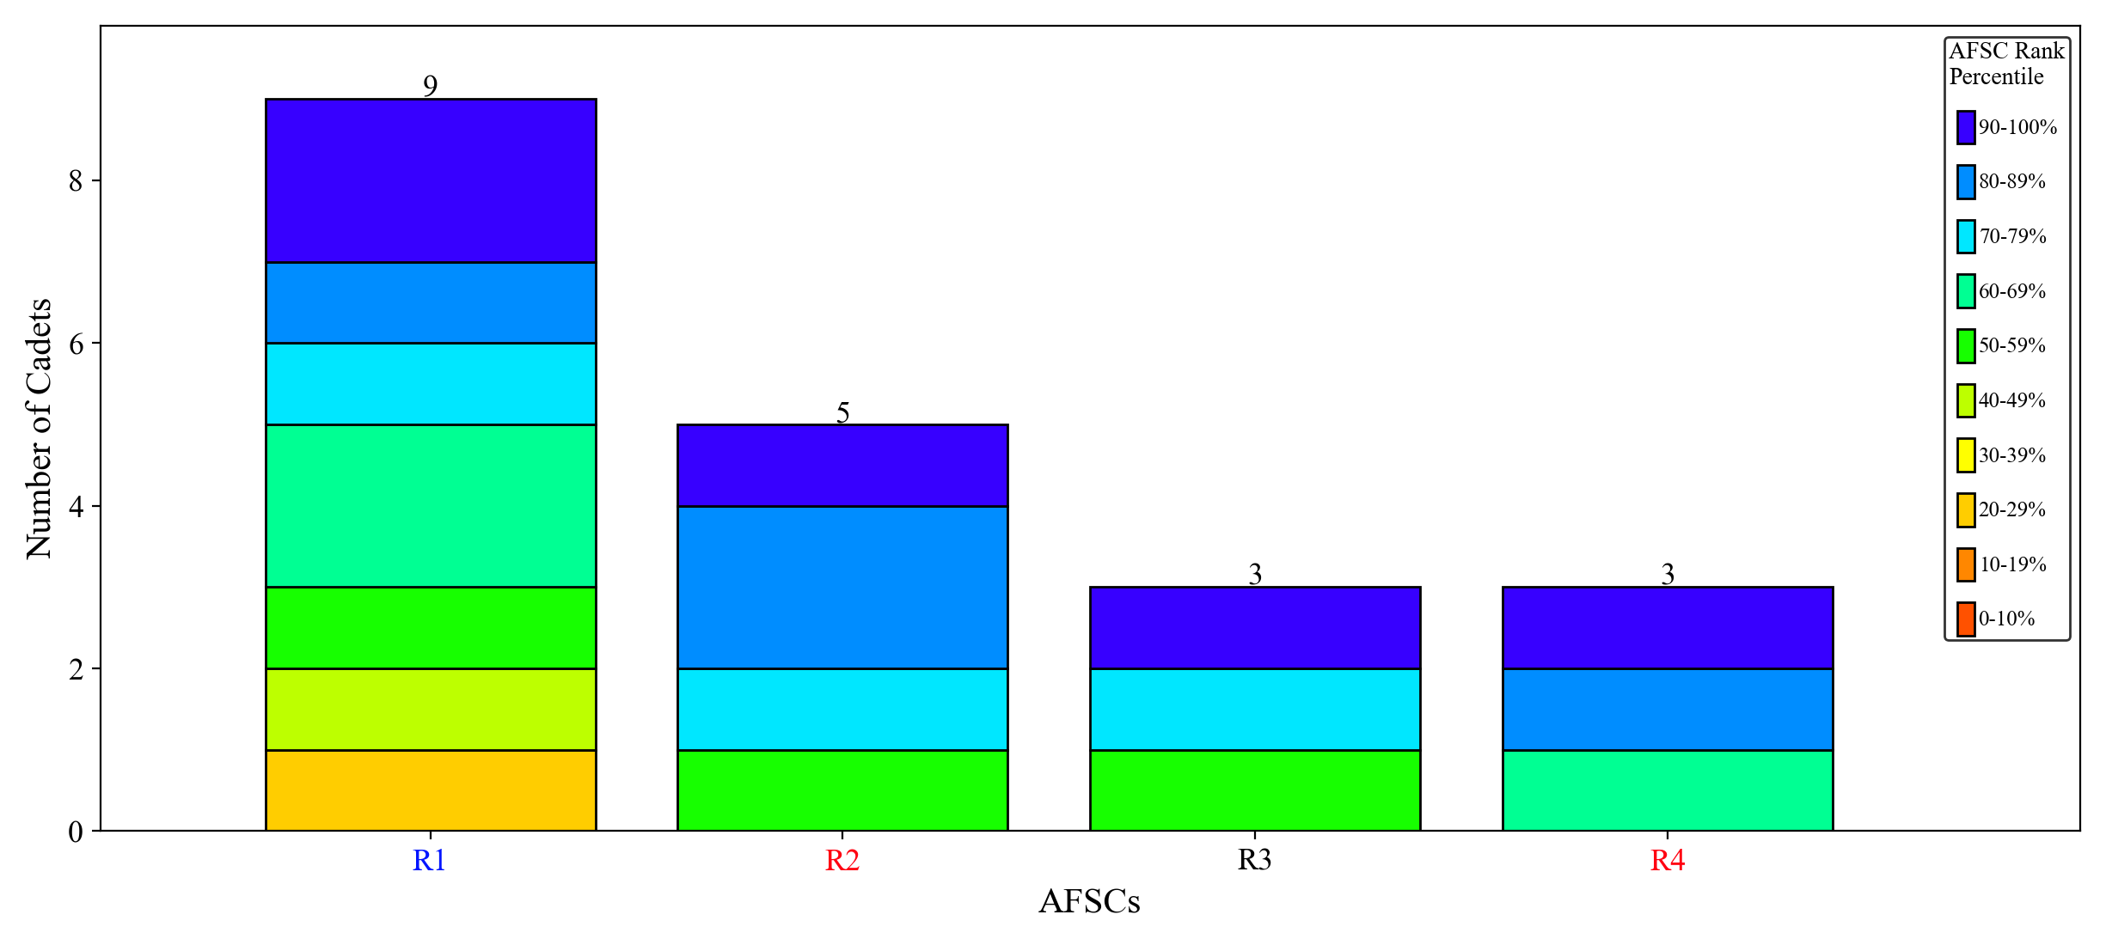
AFSC Preference

